Slide 1
Dreamweaver CS6

Slide 2




Slide 3
AGENDA
Introduction
Creating your local root folder
Creating a home page
Inserting and using tables
Previewing in browser
Creating Hyperlinks

Slide 4
INTRODUCTION
What is …
Adobe Dreamweaver ?
Why we …
Use Adobe Dreamweaver ?

Slide 5
INTRODUCTION
Dreamweaver is a complete website development and site management program.
It works with web technologies like HTML, XHTML, CSS, JavaScript, and PHP.

Slide 6
INTRODUCTION
Web Designers
Developers
Visual interface for making and editing HTML websites and mobile apps
enabling cross-platform compatibility, to create pages
http://php-editor-review.toptenreviews.com/

Slide 7
INTRODUCTION
<p align = “ ” > some text here </p>
<input type= “ " name="fname" value=“Enter First Name" />
left
center
right
password
text
submit
checkbox
radio

Slide 8
CREATING YOUR LOCAL ROOT FOLDER
Create a new folder on your local root folder
Give the folder a brief, but descriptive name. Do not use capital letters, spaces, or special characters when naming folders and files for your website. All of your pages will be saved within this folder.
Open the folder, and create another new folder inside. Name this folder “images” (make sure the file name is lower case). Put all of your images, buttons, movie files, etc. inside the images folder.

Slide 9
CREATING YOUR LOCAL ROOT FOLDER
1. Click Site > Manage Sites.
2. Click New > Site.
3. Select the Site tab.
4. Enter a name for the site in the Site Name text field (This name will be for your use only – it will not be published with your site.)

Slide 10
CREATING YOUR LOCAL ROOT FOLDER
1. Click on the Server tab located on the left side of the toolbar.
2. To add a server, click the + symbol from the bottom left-hand corner of the window.
3. Type in Server Name text field “morning_shift”.
4. Now select from Connect using selected fields Local/Network.
5. Browse Server Folder and gave path of your local root folder
6. Finally insert url in Web URL i.e http://localhost/your_folder_name

Slide 11
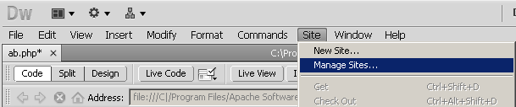
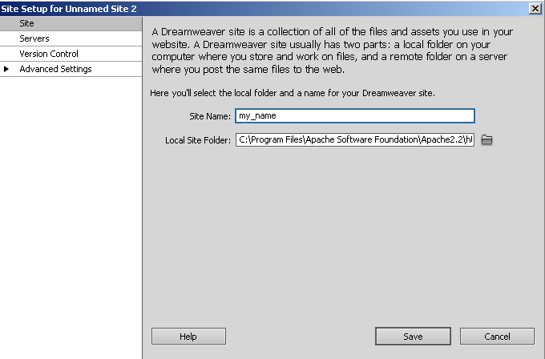
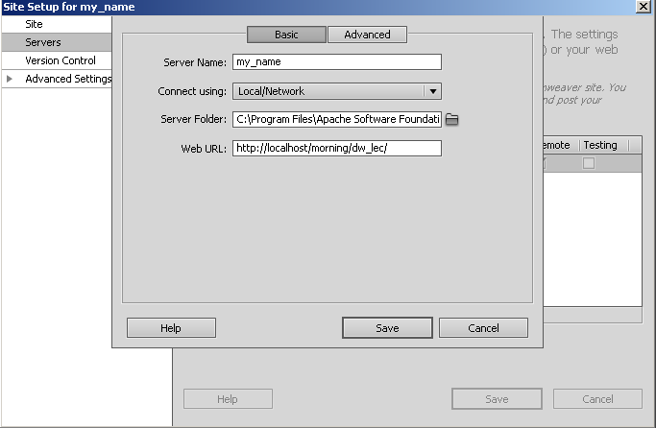
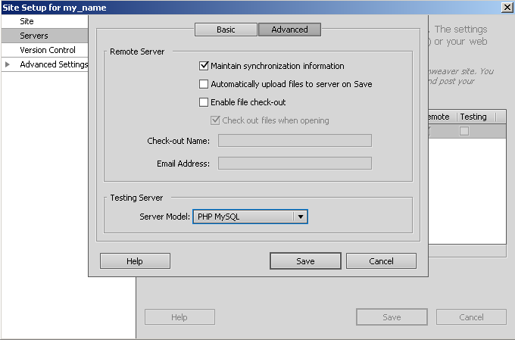
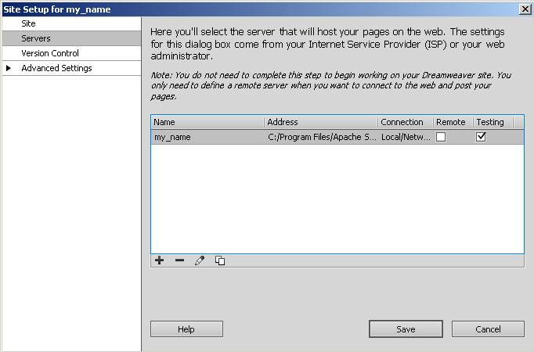
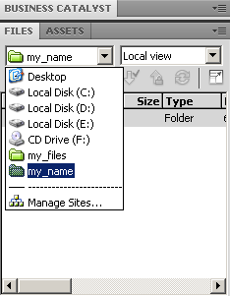
CREATING YOUR LOCAL ROOT FOLDER
2
3
1
4
5
6

Slide 12
CREATING A HOMEPAGE
1. To add a new page go to File > New and choose a basic HTML page. Save this page by clicking File >Save As. Name the first page index.html. This will be the first page that users encounter when they visit your site. Save this file to your local root folder as index.html. Naming the homepage index.html tells the Web browser that this is the first page it should open when someone visits your site.
2. After your homepage index.html is created, you can use this page as a template layout for all the other pages in your site. Simply hit Save As and name the file whatever you wish, but be sure to keep the name is simple, for example history.html, resume.html, etc. Remember not to use capital letters or spaces when naming files, this will make it easier for web browsers to find your files.
3. To save the pages of your site simply click File > Save for each page. Make sure your homepage is named index.html, and save all of your files in the folder you chose when you defined your site, i.e. in your local root folder.

Slide 13
CREATING A HOMEPAGE
Document Types
<!DOCTYPE HTML PUBLIC "-//W3C//DTD HTML 4.01 Transitional//EN"
"http://www. w3.org/TR/html4/loose.dtd“ >
is called a “doctype,” and it simply identifies what flavor of HTML you used to write the page. Developers have used two doctypes for years HTML 4.01 and XHTML 1.0—and each has two styles: strict and transitional.

Slide 14
CREATING A HOMEPAGE
Dreamweaver even lets you use the latest, greatest, and simplest doctype, HTML5
<!DOCTYPE HTML>

Slide 15
INSERTING AND USING TABLES
To insert a table, follow these steps:
In the main menu, click Insert > Table.
Insert the amount of Table Rows and Columns.
Set Table Width to between 600 and 800 pixels.
Set Border Thickness. To have a visible border type in 1 or higher, to have no border type in 0.
Cell Padding adds room inside of a cell. Enter 0 for no space or a number to Increase the space.
Cell Spacing adds space between cells. Enter 0 for no space or a number to Increase the space.
Click Ok.

Slide 16
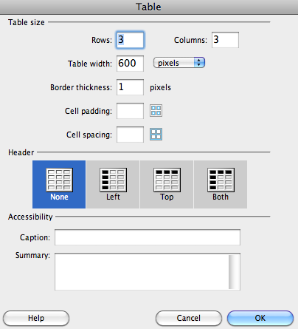
INSERTING AND USING TABLES

Slide 17

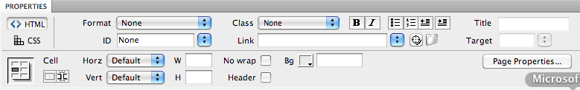
INSERTING AND USING TABLES
PROPERTIES OF TABLES
PROPERTIES OF CELLS INSIDE TABLE

Slide 18
PREVIEWING IN BROWSER
Choose File > Preview in Browser.
Hit F12.
Click on the world icon located on the toolbar at the top of your page

Slide 19
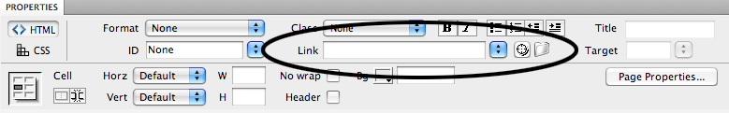
CREATING HYPERLINKS
Select the text or image you would like to make a hyperlink.
Click on the small folder next to the Link field in the Properties Inspector.
Browse through the files, and select the page you would like to link.
Click Choose.

